Slide 1
ECON 4
TOPIC 1) economic growth, cycle, development and ad/as

Slide 2
Macroeconomics
Objectives of macroeconomic policy:
Stable, low inflation (2%)
Sustainable economic growth – growth in real GDP without experiencing high inflation and without creating negative impacts on the environment
Potential economic growth – increase/improve factors of production – aims to increase productivity
High employment (low unemployment)
Improve living standards
Reduce state debt
Reduce trade deficit on the current account
Economic stability exists when prices, jobs, investment, trade, growth, interest rates and exchange rates show low volatility. A flat economic cycle shows economic stability

Slide 3
Macroeconomics
Policies to achieve macro targets:
Fiscal policy – use of government spending, taxation and borrowing
Monetary policy – use of interest rates, money supply, credit availability and exchange rates
Supply-side policies – create potential (long-term economic growth)
Monetary and fiscal generally influence AD and are designed to smooth out fluctuations in the economic cycle
Supply-side policies focus on increasing the trend rate of economic growth

Slide 4
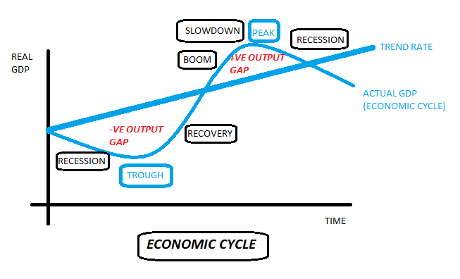
Economic cycle
BOOM = real GDP increasing at a faster rate than the trend rate. Here unemployment will be low and falling, confidence will be high, which leads to increased confidence resulting in an increase in consumption and investment. Government finances will be improving, but import demand will be high and inflation will be on the increase due to decreasing spare capacity created by a positive output gap
SLOWDOWN = rate of GDP growth slows, but is still increasing. Caution starts to creep into the economy

Slide 5
Economic cycle
RECESSION = fall in real GDP for a period of at least 6 months. The negative output gap will mean decreasing AD, a fall in employment, lower confidence and decreasing government finances. Inflation should be beginning to fall as well as import demand
RECESSION ‘V’ DEPRESSION = a depression is a prolonged recession leading to significant falls in real GDP and living standards. For a recession to become a depression, real GDP must fall by at least 10% from the peak of the cycle to the trough

Slide 6
Economic cycle
RECOVERY = when real GDP starts to increase and moves back up towards where it was before the last recession. This could be caused by macro policy e.g. expansionary fiscal and monetary. Confidence and therefore AD is starting to increase

Slide 7
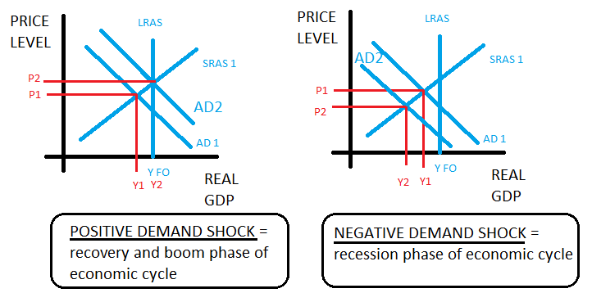
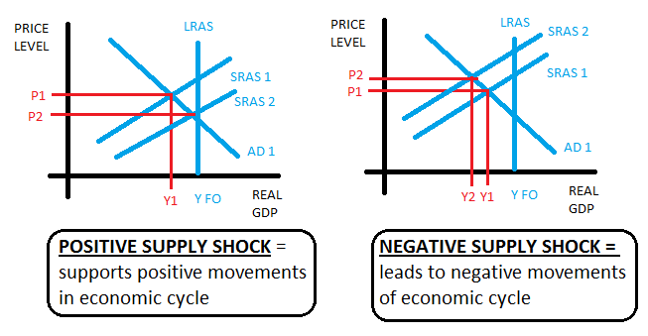
Causes of changes in the economic cycle – demand & supply shocks

Slide 8
Demand shocks
An exogenous demand shock is caused by a sudden change in a variable outside of the formula for AD e.g. currency appreciation/depreciation
An endogenous shock is caused by a sudden change in a variable within the AD formula e.g. C, I, G, X or M
AD may suddenly shift if;
Changes in confidence, unemployment, wages, profits or savings
Changes in liquidity e.g. sudden changes in the availability of credit
Wealth effects – linked to changes in prices of property, shares and bonds
Changes in government finances
Interest rate changes
Currency value changes

Slide 9
Supply shocks
SRAS may suddenly shift for the following reasons;
Changes in labour costs
Changes in otgher input costs such as raw materials
Changes in indirect taxes such as VAT
Subsidies
Productivity changes
Direct taxes such as income tax, which affect incentives to work
Labour migration

Slide 10
Long-run trend rate of economic growth
The trend rate of economic growth is the average sustainable rate of economic growth over a period of time. It is measured by potential economic growth i.e. the increase in LRAS/productive capacity. In the UK this is 2.5% per year
When actual GDP grows at a faster rate than trend growth then the economy experiences a positive output gap
When actual GDP growth is below trend rate then the economy experiences a negative output gap
What determines the long-run trend rate of growth?
Technological improvements
Labour productivity
Investment into capital and R & D
Competitiveness of firms
Labour market flexibility
infrastructure

Slide 11
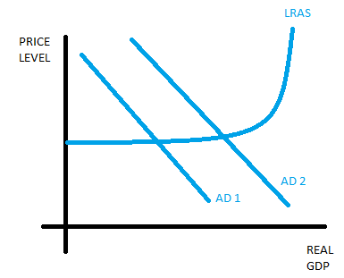
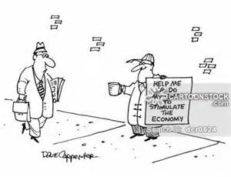
AD = C + I + G + X - M
Movements along an AD curve are caused by a change in price levels i.e. lower prices = increased AD and higher prices = lower AD
Shifts in AD are caused by non-price factors

Slide 12
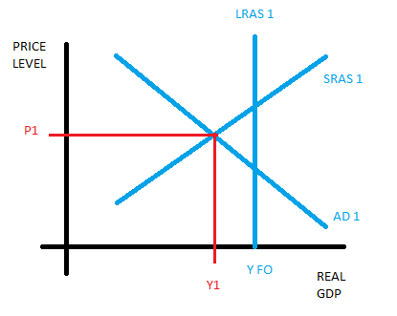
SRAS ‘V’ LRAS
SRAS assumes that capital is fixed i.e. you cannot in the short-run build a new factory, but the existing factory can be utilised more efficiently such as increased overtime of staff
Movements along SRAS are caused by changes in price levels i.e. increased prices leads to increases in SRAS and vice versa
Shifts in SRAS are caused by changes in business costs. An outward shift is caused by lower production costs and an inward shift is caused by increased business costs
The LRAS is determined by FoP. LRAS shifts outwards if FoP increase or improve

Slide 13
Keynes ‘v’ Classical LRAS
Keynes
Classical

Slide 14
Does economic growth improve living standards?
YES!!
NO!!
Increased real incomes and consumption
Improved public services
Reduced unemployment and poverty
Increased life opportunities
Increased technology and product development
Diminishing returns – economic growth when incomes are low can make massive improvements to living standards i.e. can lead to increased access to basics BUT economic growth when incomes are high will have very minimal impacts on living standards
Externalities e.g. environment problems
Inequality
Increased hours worked
Increased health problems e.g. obesity
inflation

Slide 15
Measuring the standard of living
Standard of living measures an economy’s ability to satisfy wants and needs. The most obvious way of measuring living standards is to calculate an economy’s real GDP per capita. This can be accurate and enable cross-country comparisons when:
Each economy’s real GDP per capita is converted into a common currency
Purchasing power parity is factored in i.e. the differences in the prices of products between countries
Problems with using real GDP per capita to measure living standards:
Shadow economy – black market such as illegal activities and tax evasion AND voluntary work are not included
GDP numbers can be manipulated by governments for political reasons
Inequality between regions and between different sections of society (median income could be a solution!)
What is being produced; mainly consumer goods OR capital goods?
Leisure hours and working conditions
Environmental considerations

Slide 16
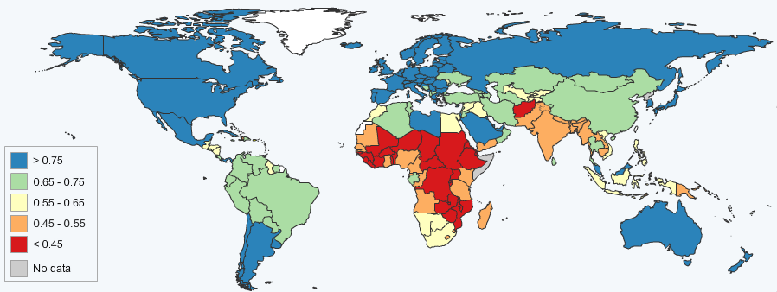
Measuring living standards – Human Development Index (HDI)
The HDI factors in:
Knowledge – average years of schooloing
Long and healthy life – life expectancy
Decent standard of living – gross national income (GNI) per capita adjusted for purchasing power parity (PPP). N.B. GNI factors in remittances and international aid payments
Outcomes of HDI:
Low HDI = 0.0 – 0.5
Medium HDI = 0.5 – 0.8
High HDI = 0.8 – 1.0

Slide 17
Limitations of HDI
HDI doesn’t factor in qualitative data such as culture and political freedoms
Doesn’t factor in inequality
PPP data changes regularly, which means data can be mis-leading

