Slide 1
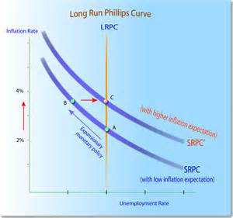
ECON 4
TOPIC 2) unemployment
& inflation

Slide 2
Types and causes of unemployment
Unemployment means that people are part of the labour force, but are not currently employed. They are therefore without paid employment, but are actively seeking employment
The labour force is the total number of people who are eligible to work (including employed and unemployed people) within an economy. The people within the labour force are economically active
Unemployment can be expressed as:
% of the labour force unemployed i.e. unemployment rate
Total number unemployed (unemployment level)
The main measurements in the UK to measure unemployment include:
The number of people claiming Job Seekers Allowance (Claimant Count)
International Labour Organisation (ILO) which defines unemployment as people without a job, want a job, have actively sought work in the last 4 weeks and are available to start work in the next 2 weeks

Slide 3
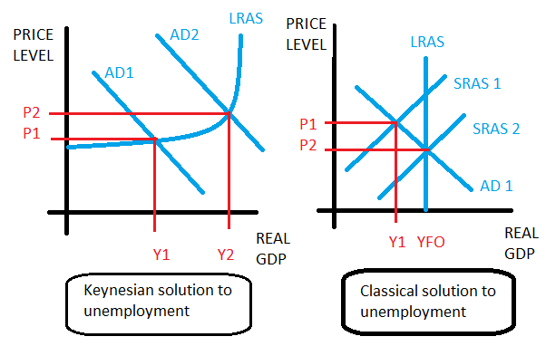
Types and causes of unemployment
Classical economists believe that unemployment is the result of supply-side problems, which means unemployment is solved by wage rates falling to create equilibrium (classical unemployment).
Keynesian economists blame unemployment on demand-side problems. This means AD needs to be increased to tackle negative output gaps

Slide 4
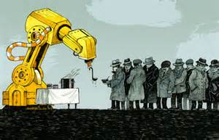
Types and causes of unemployment
Structural unemployment
This occurs when there is a long-term decline in demand in an industry leading to lower demand for labour. Causes here include; technology (technological unemployment) replacing labour and foreign competition meaning production shift location
Structural unemployment therefore means that there is a mismatch between skills and the requirements of current job vacancies. This leads to geographical and occupational immobility of labour
Cyclical unemployment
This is also known as involuntary unemployment due to a lack of demand for products. It is also known as demand-deficient unemployment
Cyclical unemployment occurs during a recession when AD falls. Falling business demand means that firms shed labour in order to cut costs and spare capacity
It can also increase during a slowdown due to increases in productivity, which often means less staff are required to produce output

Slide 5
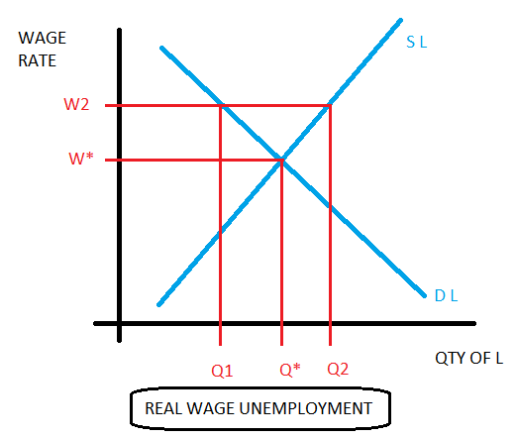
Types and causes of unemployment
Frictional unemployment
Unemployment caused by the time it takes to move between jobs. Imperfect information means that some level of frictional unemployment will always exist
Classical (real wage) unemployment
exists when the labour market cannot get to equilibrium at W*Q*. At W2 for example, the demand for labour is less than the supply of labour. Here minimum wage laws and powerful trade unions prevent equilibrium. This problem is also known as ‘sticky wages’
Voluntary unemployment
When people remain unemployed by choice. Can be caused by generous welfare packages.
Frictional unemployment can also be seen as voluntary because people choose to wait for better vacancies

Slide 6
Consequences of unemployment
Loss of income
Negative multiplier effects
Loss of national output
Fiscal. Loss of government tax revenue and increased need for government spending
Social costs – correlation exists between unemployment and crime
Loss of skills (linked to long-term unemployment) – leads to lower productivity
May lead to wage freezes or wage cuts
Long-term unemployed may become economically inactive i.e. leave the labour force
Underemployment exists where an individual is employed in a second-choice occupation or is only able to work part-time, but would like to work full-time. These people are employed BUT when is a job NOT a job?

Slide 7
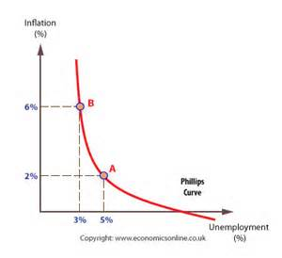
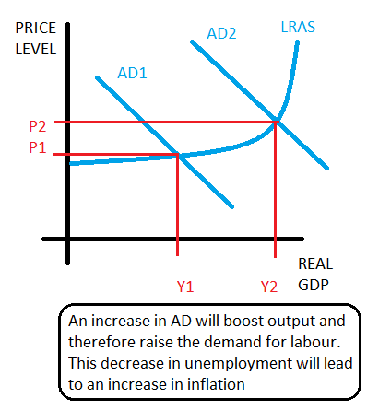
Phillips Curve
The Phillips Curve shows that an inverse relationship exists between unemployment and inflation i.e. an increase in unemployment leads to a decrease in inflation and vice versa
This therefore shows that a trade-off exists between unemployment and inflation:

Slide 8
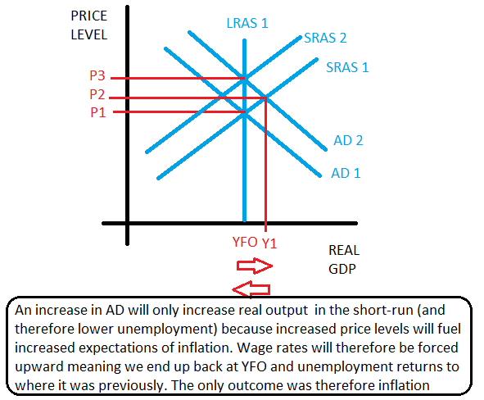
Monetarist view of Phillips Curve
Monetarists believe that in the long-run no trade-off exists between unemployment and inflation because in the long-run LRAS is fixed i.e. doesn’t change with price levels
The diagram shows that any attempt to increase output and therefore lower unemployment when operating at YFO will in the long-run only lead to inflation
Adaptive expectations theory therefore suggests that there is only a short-term trade-off between unemployment and inflation
Rational expectations suggests that workers will see an increase in AD as inflationary, so predict real wages will stay the same, so here we move straight from P! to P3

Slide 9
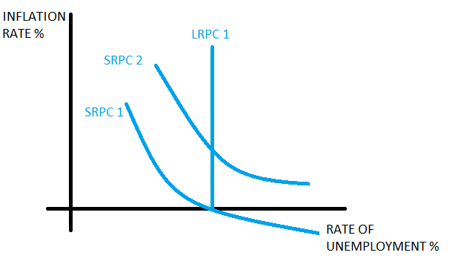
Monetarist view of Phillips Curve
When unemployment is as low as the LRPC, then an original increase in AD may temporarily raise the supply of labour to mean unemployment falls below the LRPC curve
More workers supply due to increased nominal wages, which makes work look more attractive
Despite this, people will eventually realise that inflation has increased, meaning real wages are no better than previous. This means we return to the LRPC meaning unemployment is no lower than previous albeit with higher inflation (this is adaptive expectations theory)
We now operate on SRPC2
Monetarists therefore assume that in the long-run any attempt to cut unemployment by raising AD to get unemployment below LRPC will only result in increased inflation

Slide 10
Monetarists ‘v’ Keynesian view
Monetarists argue that unemployment is a supply-side problem and therefore requires supply-side solutions. Any attempts to cut unemployment by boosting AD will in the long-run only create inflation. Monetarists believe that unemployment is determined by the natural rate of unemployment (NRU)
Supply-side problems = job information, immobility and benefit systems
Keynes argues that unemployment is demand-deficient i.e. is caused by AD being below full capacity and can get stuck there due to ‘sticky wages’. AD therefore needs to be increased
Demand-side problems = spare capacity and low demand leads to demand-deficient unemployment
When inflation and unemployment increase together, then the economy experiences ‘stagflation’

Slide 11
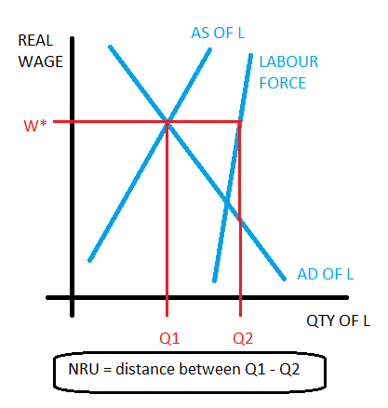
The Natural Rate of Unemployment (NRU)
The NRU is the rate of unemployment when the labour market is in equilibrium. It is the difference between those who would like a job at the current wage rate and those that are willing and able to take a job
The NRU is unemployment caused by supply-side problems. This therefore means that it includes:
Structural unemployment
Frictional unemployment
THE NRU = LRPC!
THE LRPC/NRU is also known as the non-accelerating inflation rate of unemployment i.e. at this rate of unemployment there is no tendency for inflation to increase
Any attempt to boost AD to cut unemployment below the NRU will in the long-run only increase inflation

Slide 12
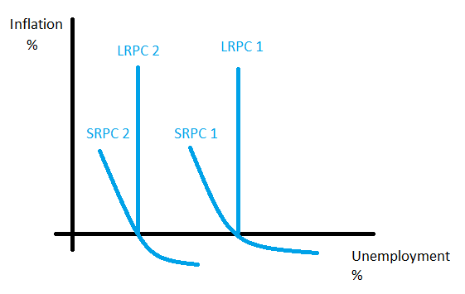
What affects the NRU?
The NRU is determined by:
Availability of job information (affects frictional unemployment)
Skills and education – affects occupational mobility
Degree of labour mobility e.g. geographical
Flexibility of labour markets e.g. powerful trade unions can prevent supply into a market
Hysteresis – unemployment created by a recession can increase the NRU because this unemployment can mean workers lose skills and motivation to work
The UK has significantly cut the NRU by:
Reducing trade union power (made labour markets more flexible)
Privatisation which makes markets more competitive = more flexible labour market
Improved education and training
Decreased ability to live on benefits

Slide 13
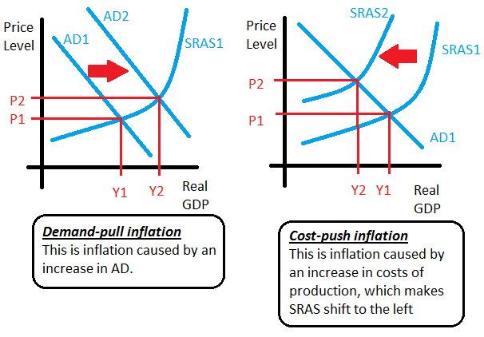
Inflation
Inflation is defined as a sustained increase in the general price level
Inflation can be caused in one of two ways; on the demand-side (demand-pull inflation) OR on the supply-side (cost-push inflation)
If we have a one-off shift of either AD or SRAS then the inflation is only a one-off.
Persistent inflation is often caused by an increase in the money supply. The money supply measures the quantity of money in circulation within the economy
If money supply increases by more than output then we will see an increase in spending which drives up AD. Savings will also increase, which will drive down interest rates and therefore encourage borrowing, which will further increase AD. Eventually people become to expect more inflation, so accelerate buying to beat price increases. This encourages more inflation

Slide 14
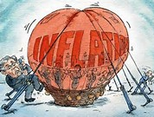
Inflation
Causes of demand-pull inflation
Causes of cost-push inflation
Depreciation of the currency
Expansionary fiscal and monetary policy
Economic growth from other parts of the world
Increase in raw material and other input costs
such as labour costs
Increased inflationary expectations – leads to workers increasing pay expectations
Increased indirect taxes
Currency depreciation – increases import costs of raw materials and semi-finished goods

Slide 15
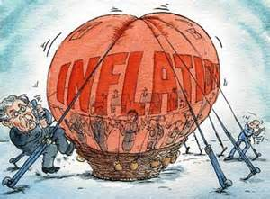
inflation
Inflation measures the rate of increase in the average price level in an economy
If prices constantly fluctuate, then the economy experiences instability. This will in-turn make planning for households and firms difficult, which often deters investment within the economy
Measuring inflation:
STAGE 1 = identify a typical ‘basket of goods and services’ which represents the spending patterns of an average household
STAGE 2 = Calculate the price of this basket of goods within the base year (attach 100 index points to the value). We also place weightings on different goods and services, which reflect how much income is spent on particular goods and services. This then gives us a weighted price index
STAGE 3 = in following years, the price of this basket of goods is also calculated. We then compare the price against the base year. The change in price of the basket of goods will show us the inflation rate

Slide 16
Calculating a weighted price index
Imagine the average basket of goods contains 3 items (A,B and C)
Weightings = (A = 35%, B = 40%, C =25%)
Good | Price in year 1 (£) x weighting | Price in year 2 (£) x weighting | Price in year 3 (£) x weighting | Price in year 4 (£) x weighting
A | 37.1 | 39.2 | 45.15 | 45.5
B | 18.8 | 20.4 | 26.4 | 27.2
C | 14.75 | 15.5 | 19.75 | 20.25
TOTAL | 70.65 | 75.1 | 91.3 | 92.95
Good | Price in year 1 (£) | Price in year 2 (£) | Price in year 3 (£) | Price in year 4 (£)
A | 1.06 | 1.12 | 1.29 | 1.30
B | 0.47 | 0.51 | 0.66 | 0.68
C | 0.59 | 0.62 | 0.79 | 0.81
YEAR 1 = 100 INDEX POINTS
YEAR 2 = 75.1 / 70.65 X 100 = 106 INDEX POINTS
YEAR 3 = 91.3 / 70.65 X 100 = 129.2 INDEX POINTS
YEAR 4 = 92.95 / 70.65 X 100 = 131.6 INDEX POINTS
YEAR 2 INFLATION = 6/100 X 100 = 6%
YEAR 3 INFLATION = 23.2/106 X 100 = 21.9%
YEAR 4 INFLATION = 1.65/129.2 X 100 = 1.3%

Slide 17
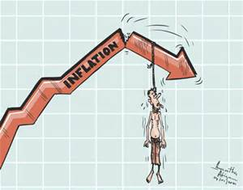
Measuring inflation – CPI
The consumer price index (CPI) is a measure of the general level of prices in the UK. The rate of change measures the inflation rate
CPI is calculated by:
Including 180,000 individual price quotes on 680 different products by visiting shops, phone-calls and internet research
Data on spending from The Household Final Monetary Consumption Expenditure survey is used to calculate weightings
Weightings are updated annually to reflect changes in consumer spending patterns
CPI doesn’t included housing costs of owner-occupiers. CPIH was created to include these costs
% change in CPI is used to calculate inflation rate

Slide 18
Measuring inflation – RPI
The retail price index (RPI) is a measure of the average level of prices in the UK. It was the main tool of the government before CPI to calculate the impacts of price increases on the economy.
RPIX used to calculate the RPI, but excluded mortgage repayments. This is because mortgage payments are based on interest rates. Interest rates are increased to curb inflation. This therefore meant that higher interest rates would show an increase in inflation on the RPI tool BUT not on RPIX
CPI has now replaced RPIX
Differences between RPI and CPI
RPI excludes pensioner households and highest income earners. CPI does not
RPI includes the costs of housing (mortgage interest costs and council tax for example) while CPI does not.
CPI is more complex in terms of its calculation – its better at considering weightings
UK INFLATION TARGET = 2%

Slide 19
Deflation
Deflation measures a fall in the average level of prices (negative inflation)
Disinflation measures a fall in the rate of inflation
Do not confuse deflation AND disinflation!
Deflation is seen as bad for an economy because if people expect price levels to fall then they delay making purchases because they believe they can buy cheaper in the future. This can therefore lead to a recession and an increase in unemployment
Despite this recently the UK experienced deflation. This was caused by cheaper fuel and food. This was good for the economy because people cannot delay buying these items. It actually freed up more of household income to purchase other goods and services within the economy

Slide 20
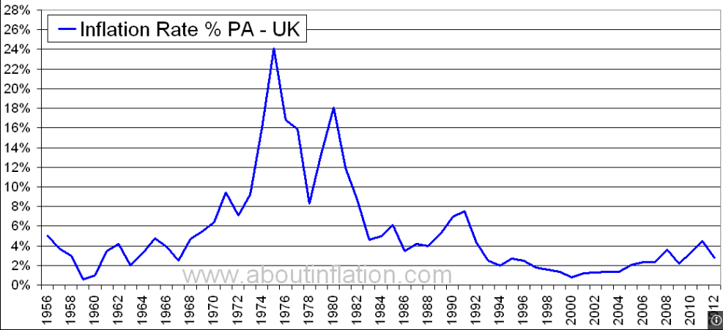
Recent UK inflation
1970s = high inflation. This was caused by high oil prices & the movement away from a fixed exchange rate to a floating exchange rate.
1980s= inflation was back under-control. This was the consequence of Thatcherism. Here interest rates were increased to reduce consumer spending
UK inflation target = 2%. This controlled mainly in the UK via monetary policy

Slide 21
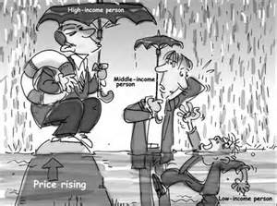
Consequences of inflation
Income and wealth inequality – inflation impacts more on poorer sections of society (inflation is therefore regressive)
Falling real incomes
Negative real interest rates – impacts negatively on saver who have an interest rate lower than the rate of inflation
Inflation leads to higher interest rates, which leads to increased borrowing costs
Risks of increased wage rates (wage-price spiral)
Lower business competitiveness in global markets
Uncertainty – can impact on consumption and investment

Slide 22
Monetarist Theory of Inflation
Monetarists argue that if money supply increases at a faster rate than the growth of output then we experience inflation. This means that if money supply grows at the same rate as output then we wouldn’t experience inflation
The Quantity theory of money can be summed up by the Fisher equation:
M X V = P X Y
M = money supply
V = velocity of circulation (assumed to be fixed e.g. people get paid at regular interviews)
P = price levels
Y = national output (Monetarists assume that this is fixed in the long-run
Therefore because V and Y are fixed, money supply directly influences price levels. This means if money supply increases by 10%, then price levels increase by 10%
An increase in money supply will take between 9-12 months to increase output, a year later price levels increase to accommodate the increase in money supply

