Slide 1
ECON 4
TOPIC 3) monetary policy

Slide 2
Monetary policy
Monetary policy is the use of interest rates, money supply and exchange rates to influence AD. UK monetary policy is officially tasked with keeping price stable (inflation rate of 2%)
Monetary policy is controlled by a nation’s central bank (in the UK this is the Bank of England)
Expansionary (loose) fiscal policy is used to boost confidence, demand and output. This involves:
Low nominal interest rates (currently 0.5%)
Quantitative easing (expansion of money supply)
Incentives for banks to increase lending
Consequence of above is a curren cy depreciation, which leads to more competitively priced domestic products, which fuels a growth in exports and reduces imports
Contractionary monetary policy is used when inflation is running above 2%. Here interest rates are increased, money supply is reduced, which in turn leads to a currency appreciation and therefore reduced export demand

Slide 3
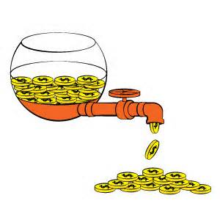
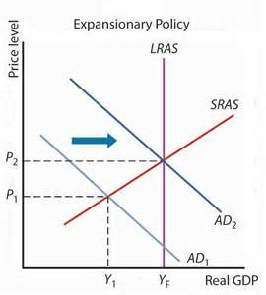
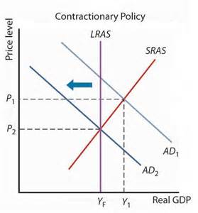
Monetary policy
Expansionary monetary policy
Contractionary monetary policy
Used during a negative output gap
Used during a positive output gap

Slide 4
The Bank of England (BoE)
The BoE is responsible for UK monetary policy and maintaining financial stability. The BoE is issues targets from the government, but is independent when setting policies.
The role of the BoE - Monetary Policy Committee (MPC) along with the Governor of the BoE meet monthly to discuss what the nominal base rate of interest should be (based on the CPI – target = 2% BUT a 1% swing either side of this is permitted)
Factors considered when setting interest rates (MPC looks at predictions 2 years ahead):
GDP growth and spare capacity
Bank lending figures
Share prices and house prices
Consumer and business confidence
Growth of wage rates
Unemployment data
Exchange rates
International data

Slide 5
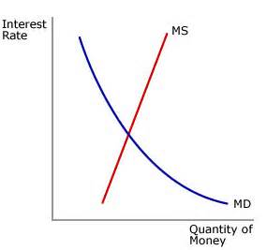
Monetary policy - diagrams
Money is demanded to be spent. Lower interest rates will raise the demand for money, lower savings and increase borrowing.
Money supply will increase as interest rates increase
The equilibrium interest rate (r*) exists when the MS = MD

Slide 6
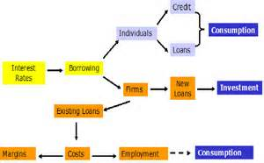
Transmission Mechanism of monetary policy
When interest rates influence AD, output and price levels we call it the transmission mechanism of monetary policy. This can be done by:
Changing the base interest rate. When this happens, commercial banks and building societies change their interest rates accordingly. This will influence borrowing rates and returns for savers
This in turn will influence consumption and investment, which will influence AD, output and price levels.
How do interest rates affect AD, output and employment?
Affects housing market and therefore house prices
Impacts on disposable income of mortgage payers
Disposable incomeon savers
Consumer demand for credit
Business investment

Slide 7
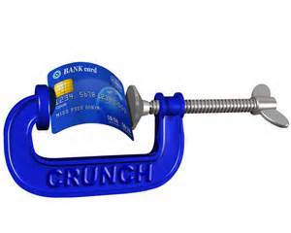
Limitations of monetary policy
Looser monetary policy i.e. lower interest rates may not significantly increase AD and output because:
Unwillingness of banks to lend
Low consumer confidence
High levels of existing private sector debt
Falling or slow-rising asset prices e.g. houses
Falling real incomes
Depreciated currency may not boost exports due to poor economic performance in trading partners
Liquidity trap – if people cannot or choose not to borrow even with lower interest rates, then the economy has a liquidity trap

Slide 8
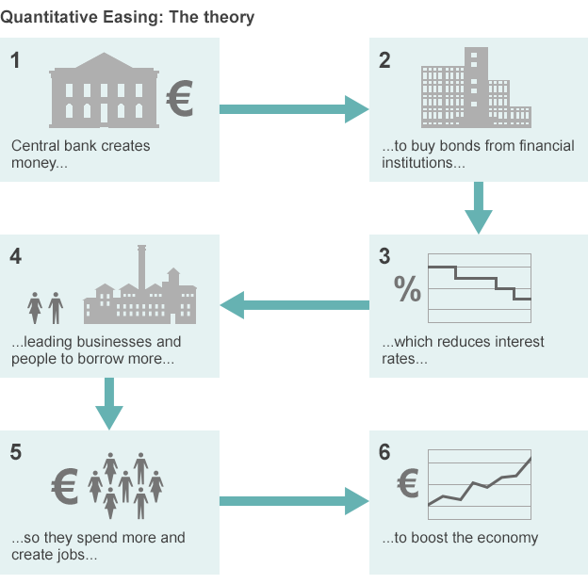
Quantitative easing
Here the BoE increase the supply of money in the banking system in order to reduce recessionary problems. This is done when interest rates are as low as they can go, but a recession still looms
The BoE uses this money to buy mainly government bonds from financial firms such as banks. This now means that banks have increased access to funds, which incentivises an increase in funds available to lend to firms and households. This should stimulate an increase in AD, output and price levels

Slide 9
Monetary policy and exchange rates
The £ will appreciate when interest rates increase and money supply is cut i.e. when contractionary monetary policy is used. This means that using contractionary monetary policy when the economy is operating with a positive output gap:
Import prices fall, export prices increase = lower domestic production = increased trade deficit = lower domestic employment = lower inflation
The £ will therefore depreciate when interest rates are cut and when money supply is increased i.e. when expansionary monetary policy is used. This means that using expansionary monetary policy when the economy is operating with a negative output gap:
Import prices increase, export prices fall = increased domestic production = reduced trade deficit = increased domestic employment = increased inflation

Slide 10
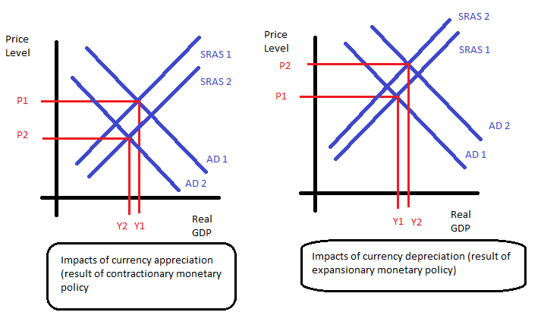
Monetary policy and exchange rates
Currency appreciation
Currency depreciation

