Slide 1
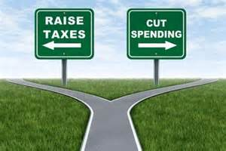
ECON 4
Topic 4) fiscal and
supply-side policies

Slide 2
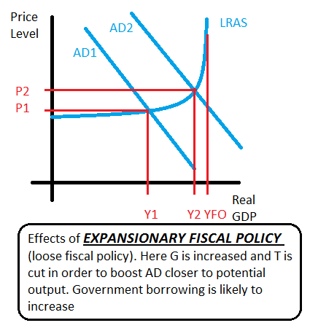
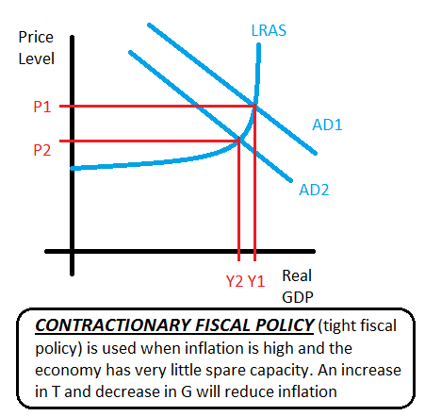
Fiscal Policy
Fiscal policy involves the government changing levels of taxation, government spending and borrowing in order to influence AD (total level of planned expenditure in an economy) and therefore the level of GDP
Fiscal policy is used to prevent both BOOMS and BUSTS i.e. guard the economy against recession in a trough and high inflation in a positive output gap

Slide 3
Objectives of fiscal policy
Impact AD
Change the pattern of spending on goods and services
Redistribute income and wealth
Correct market failures e.g. merit/demerit goods, public goods, externalities
Create potential economic growth i.e. encourage an improvement/increase in FoP

Slide 4
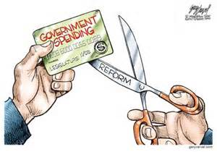
Fiscal policy – government spending
Areas of government spending:
Transfer payments – this includes welfare which is payments through the social security system. This includes some universal benefits or means tested benefits. Transfer payments also includes subsidies to firms
Current government spending – day-to-day running of the public sectors e.g. salaries paid to workers in education, police and health. These are regular payments
Capital spending – infrastructure projects designed to improve and increase both capital and labour stocks. These will have impacts on AD and AS
Government spending is important because it ensures:
Public and merit goods are provided
A safety net exists and redistributes money to ensure better life chances
Provide essential infrastructure and encourage R & D and entrepreneurs

Slide 5
Fiscal policy - taxes
Income tax – a progressive tax on incomes. Tax is paid on any income over £10,400. A negative income tax is also possible i.e. low income people pay negative tax on incomes – ultimately means incomes are subsidised through benefits
National Insurance contributions – another tax on incomes
VAT – consumption tax i.e. a tax on goods and services (20%)
Excise duties – additional taxes on goods such as tobacco, alcohol and fuel
Stamp duty – tax on buying houses/shares
Corporation Tax – tax levied on profits of firms
Taxes can either be;
Progressive – as income increases, a higher % tax is paid
Regressive – when an increase in income leads to a smaller % of income going on that tax
Proportional – where an increase in income leads to same % increase in tax
Direct (paid directly by the tax payer e.g. income tax) and indirect (can be passed on to others e.g. VAT

Slide 6
Fiscal policy - taxes
Taxes need to consider Equity (fairness):
Horizontal equity – equal treatment of people in the same situation i.e. people on similar incomes pay the same % of income as tax
Vertical equity – redistribution from the better off to the worse off i.e. use of progressive taxes, which means the better off pay more than the worse off
Requirements of a good tax system:
Ensure adequate horizontal and vertical equity
Cheap to collect
Difficult to evade
Don’t dis-incentivise work and enterprise
Easy to understand

Slide 7
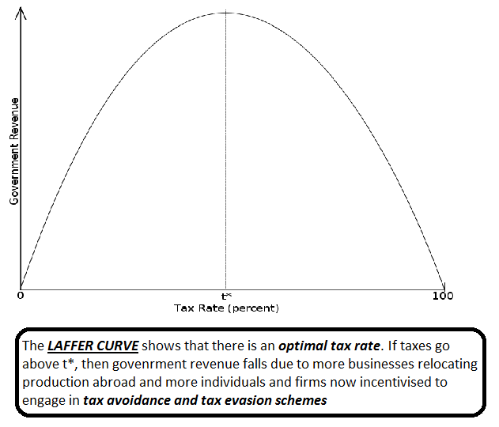
Fiscal policy - taxes
Why tax?
Raise revenue for the government
Promote redistribution of income and wealth
Discourage consumption of demerit goods and negative externalities i.e. correct market failure

Slide 8
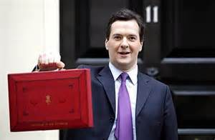
UK fiscal policy
UK budget deficit (as a % of GDP)
2009-10 | 2010-11 | 2011-12 | 2012-13 | 2013-14 | 2014-15 | 2015-16
-11.2% | -9.5% | -7.9% | -5.1% | -6.1% | -5.2% | -4.2%
2009-10 = expansionary fiscal policy aimed at reducing the negative impacts of recession.
Recent policy has focussed on ‘deficit reduction’ i.e. reduce the size of budget deficits. This will reduce new borrowing. This policy is also known as ‘austerity’. Recent austerity policies:
Increased rate of VAT (indirect taxes), increased NI contributions, deep cut in G, especially welfare payments
Overall government debt currently stands at approximately £1.5trillion

Slide 9
Fiscal policy key terms
Fiscal stance – whether fiscal policy is currently designed to increase or decrease AD
Neutral fiscal stance – balanced budget
Reflationary fiscal stance – budget deficit
Deflationary fiscal stance – budget surplus
Automatic stabilisers – G and T adjusting without the need for government policy changes. For example, during a recession G automatically increases due to increase unemployment leading to increased welfare payments. Also, reduced spending results in less VAT coming into the government i.e. G increases and T decreases
Multiplier effect – where an increase in injections leads to a larger increase in real GDP than the original injection
Injections – increase in expenditure within the circular flow (government spending, investment & exports)
Leakages – decrease in expenditure within the circular flow (taxation, savings and imports)

Slide 10
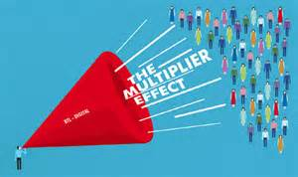
Is fiscal policy effective?
Criticisms/evaluation
Does the government have sufficient knowledge of the economy to use fiscal policy effectively?
Time lags – government spending changes can take several months to trickle into the economy. Its impact may therefore be too late
Crowding out – too much government spending will potentially reduce private sector investment. If money is spent by the government, then there are less funds available to be spent by the private sector. This can also force up interest rates, if government debt increases
Will government spending be used efficiently OR will it be wasted on inefficient projects?
Increased borrowing and interest repayments of debt
How big a multiplier effect will it create?
Can government access borrowing at low interest rates? If bond yields are too high, then the government may not be able to justify borrowing?
Other factors may limit its impact e.g. the global economy and domestic monetary policy

Slide 11
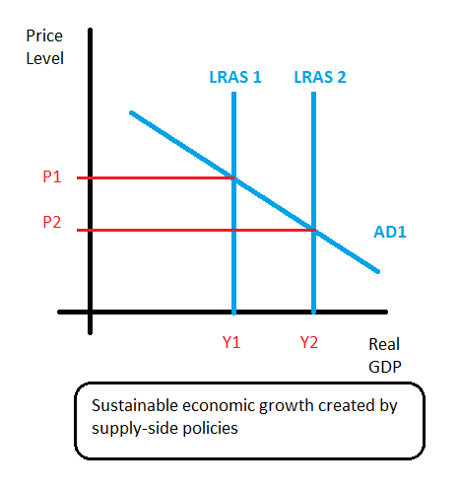
Supply-side policies
Supply-side policies are mainly micro i.e. attempt to make markets work more efficiently, which at a macro level leads to an increase in potential economic growth (LRAS)
Supply-side policies can lead to economic growth without the problems of inflation
Targets of supply-side policies:
Increase incentives to work and enterprise i.e. invest
Improve labour and capital productivity
Reduce geographical and occupational immobility of labour
Reduce the Natural Rate of Unemployment
Promote competition

Slide 12
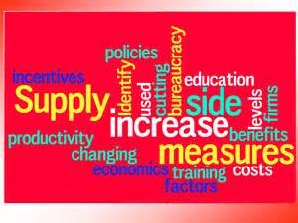
Supply-side policies
Main supply-side policies:
Cut business taxes to stimulate investment and R & D
Cut income taxes to incentivise hard-work and employment
Promote competition between firms e.g. deregulation and anti-cartel laws
Market liberalisation – open up the domestic market to foreign competition
Increase government spending to improve infrastructure and human capital

