Slide 1
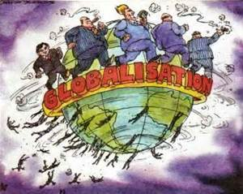
ECON 4
TOPIC 5) GLOBALISATION

Slide 2
Characteristics of globalisation
Globalisation is a process of creating increased economic integration between countries. This will lead to:
Increased levels of international trade
Increased flows of capital such as foreign direct investment (FDI) by multinational companies (MNCs)
Development of global brands
Firms increasingly having a global supply chain – increased out-sourcing and off-shoring
Increased power of developing nations such as India, Brazil and China
Increased interdependency between nations

Slide 3
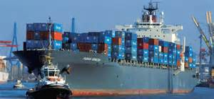
Causes of globalisation
Containerisation – containers and larger ships have reduced shipping costs. This makes international trade more viable
Technological change – increased ability and reduction in cost of communication technology
Economies of scale – larger outputs are now required to operate at lowest average cost. This means firms now increasingly need to operate on a global scale in order to compete and be efficient
Opening up of global financial markets – this leads to more access to global economies
Reduced protectionism across the world
Saturation of domestic markets – means firms increasingly move abroad to exploit new growth opportunities
Establishment of trade blocs such as NAFTA and EU

Slide 4
Benefits of globalisation
Increased free trade – this promotes specialisation, increased efficiency, lower prices, increased choice, competition and economies of scale
Free movement of labour – allows countries to fill skill-gaps and allows low-paid workers from developing countries to improve their living standards by moving to richer economies
Increased economies of scale – increased specialisation and producing at a larger output level allows firms to reduce average production costs = lower prices
Greater competition – domestic firms now face increased competition from foreign firms. Leads to improved choice, lower prices and improved quality
Increased investment – increased access to FDI and MNCS. This leads to the spread of technology and improved capital for receiving nations

Slide 5
Costs of globalisation
Free trade can prevent infant industries from establishing themselves within a market. We also have ‘the paradox of free trade’. Here free trade tends to benefit developed nations more than developing. The developed world often place tariffs on imports from developing nations
Environmental costs – increased use of fossil fuels to transport goods and services across the world. Also, MNCs are known to relocate production to where environmental restrictions are more generous. Leads to increased creation of greenhouse gases
Labour drain – loss of skilled workers (mainly from developing to developed nations)
Increased homogenisation
To encourage FDI, Corporate Tax rates needs to be low. This leads to governments having to place increased taxes on VAT and income tax. MNCs are also known to locate to low tax economies and then channel profits made elsewhere back to these countries

Slide 6
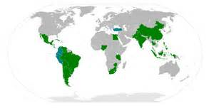
Do developing nations benefit from globalisation?
Export-led growth
FDI/MNCs = develops domestic markets, creates jobs and also allows increased access to technology
BUT
Might struggle to compete with established firms from developed nations
Might end up only creating primary products (its what they are best at). This prevents them developing a manufacturing base

Slide 7
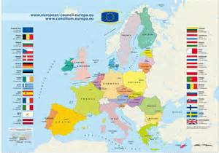
Trading Blocs and Regional Trade Agreements
Bi-lateral trade deals are when two economies agree to lower the use of protectionist policies to promote trade between the two nations. This is known as trade liberalisation
Regional trade agreements are the same as above, but are between a group of nations. Examples of regional trade agreements include:
European Union (EU)
European Free Trade Area (EFTA)
North American Free Trade Agreement (NAFTA)
Association of Southeast Asian Nations (ASEAN)

Slide 8
Multinational Corporations (MNCs)
Benefits
Drawbacks
Inward investment of FDI – allows nations to receive increased levels of foreign currency
Increased economies of scale
Increased research and development and technology transfers between countries
Ensures minimum standards e.g. a Toyota car will be standardised in terms of minimum levels of health and safety
Increase in global monopolies who achieve high levels of profit at the expense of consumers
Infant industry argument
Local firms can often be forced out of markets
Increased environmental concerns
Exploitation e.g. low wage rates offered in developing economies (BUT only low compared to developed standards)

Slide 9
International trade – comparative advantage
International trade is the exchange of products between nations.
The gains from international trade can shown by comparative advantage. This is a theory devised by David Ricardo in 1817. This exists when the marginal cost of production is lower in one country compared to another. It is also where one country can produce at a lower relative opportunity cost compared to another country
Assumptions of comparative advantage:
Switching resources between industries is costless and resources can be as efficiently employed in alternative industries
Constant returns to scale – scaling up production offers no economies or diseconomies of scale

Slide 10
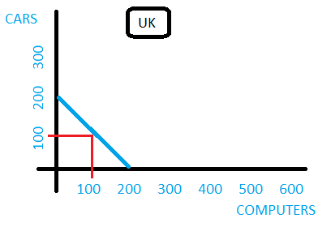
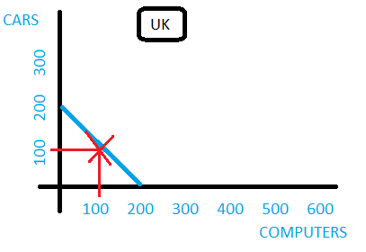
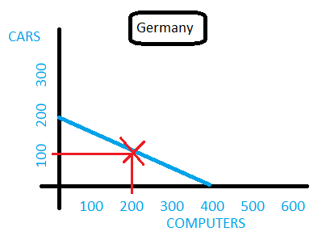
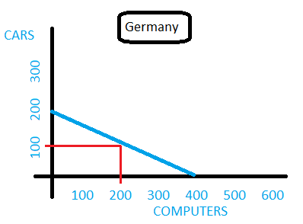
Comparative advantage – worked example

Slide 11
Comparative advantage – worked example (cont)

Slide 12
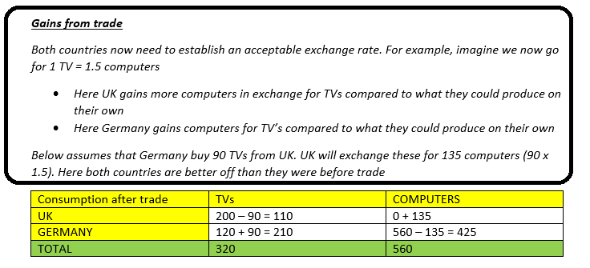
Comparative advantage – worked example (cont)

Slide 13
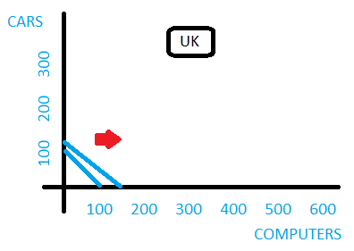
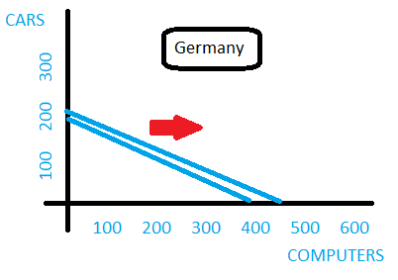
Comparative advantage – worked example (cont)
PPBs before trade
Trading possibility boundary

Slide 14
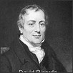
Sources of comparative advantage
Comparative advantages can be gained and lost over-time. Factors that will influence comparative advantage include:
Quantity and quality of factors of production available
Funds available for investment
Quality and quantity of infrastructure available
Exchange rate
Levels of protectionism

Slide 15
Absolute advantage
Absolute advantage exists where one country can produce a product cheaper than another i.e. they need to use less resources to produce a product than another country
Having absolute advantage doesn’t necessarily mean a country should produce that product – they would need a comparative advantage

Slide 16
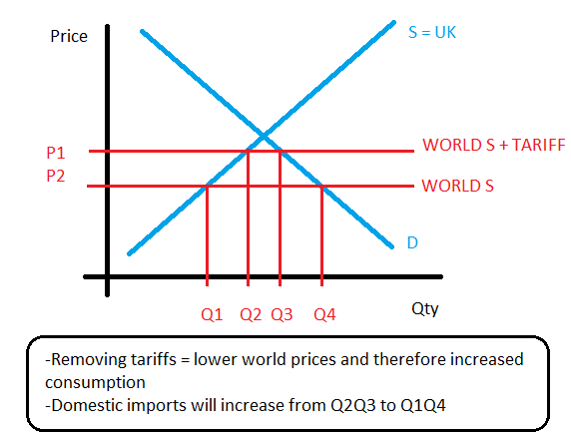
Benefits of free trade
Benefits created by comparative advantage – specialisation leads to increased global production = improved economic welfare
Trade creation – this exists when consumption shifts from expensive domestic products to cheaper foreign products
Increased exports
Economies of scale
Increased competition
Gets resources to where they would be of most use
Tariffs take away competition, which can lead to inefficiency

Slide 17
Arguments against free trade
Infant industry argument - protectionism can allow firms to grow and eventually develop comparative advantages
Senile industry argument – protectionism gives old, inefficient firms the incentive to invest to become efficient BUT tariffs can also incentivise inefficiency
To diversify the economy – free trade leads to an economy producing only a narrow range of products. This can be dangerous e.g. relying on financial services during a global credit crunch. Protecting and developing new industries can spread risk across an economy
Raise revenue for the government – import taxes can raise funds for the government
Improve current account – protectionism can reduce imports BUT this runs the risk of retaliation
Cultural identity – protecting national identities from globalisation
Protection from dumping i.e. preventing other economies dumping spare products into your markets at a low price
Environmental problems – created by firms relocating production to low-cost economies where environmental laws are more relaxed

Slide 18
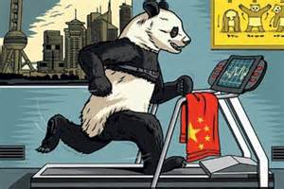
The pattern of trade
The pattern of international trade has changed significantly over the last 3o years. The main changes include:
Emergence of regional trade blocs. This leads to increased trade between members BUT this has created trade diversion where members shift trade away from non-members to members
Advanced, developed economies such as the UK have experienced deindustrialisation, but have developed advantages in service sector and quaternary industries
The collapse of communism has led to increased trade with East Europe and Russia
The rise of emerging economies such as India and China

Slide 19
World Trade Organisation (WTO)
WTO focusses on promoting free trade across the global economy. It does this by:
Trying to resolve conflicts between different economies
Lowering trade restrictions between economies
Protect international copyright laws

Slide 20
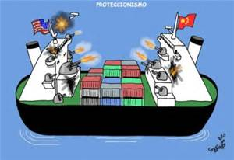
Protectionism
Protectionism is an attempt to impose restrictions on trade in goods and services. Examples of protectionism include:
Import tariffs
Quotas
Voluntary export restraint
Intellectual property laws
Domestic subsidies
State procurement

