Slide 1
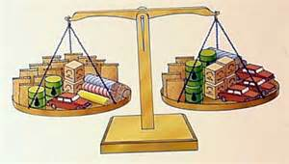
ECON 4
TOPIC 6) balance of
payments

Slide 2
Balance of Payments (BoP)
BoP records all financial transactions made between consumers, businesses and the government in one country with other countries.
The BoP is made up of:
Current Account
Capital Account (Financial Account)
Balance of trade in goods
Balance of trade in services
Net investment income
Net overseas transfers
Net balance of FDI
Net balance of portfolio investments
Net balance of short-term banking flows (hot money)
The overall BoP must balance i.e. Current Account + Capital Account = 0

Slide 3
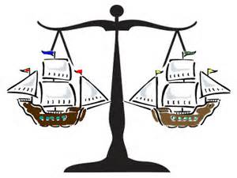
Balance of Payments (BoP)
The BoP shows us:
The value of imports into the country compared with the value of exports from the country
Inflows of foreign currency compared to outflows of foreign currency
A current account surplus means that there is a net inflow of foreign currency. This then means that a deficit can be run on the capital account i.e. foreign currency can be used to make investments abroad
A current account deficit means that there is a net outflow of foreign currency. This then means that a surplus is required on the capital account. The country will need to attract investments of foreign currency back into the economy to ensure that we can carry on paying for our imports. Countries here therefore have to be good at attracting foreign direct investment

Slide 4
What are the causes of a current account deficit?
A Current Account can either be:
Trade deficit = where the value of imports exceeds the value of exports
Trade surplus = where the value of exports exceeds the value of imports
Trade balance = where the value of imports = value of exports
Causes of a trade deficit:
Overvalued exchange rates – this lowers competitiveness. Imports become cheaper and export more expensive
High consumer spending – this is particularly likely to cause a growing trade deficit if consumers have a high marginal propensity to import
Unbalanced economy – an economy based on consumer spending as opposed to investment and exports
Lack of competitiveness of domestic firms – in terms of price and quality

Slide 5
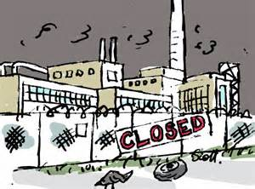
What are the causes of a current account deficit?
Causes of a trade deficit:
Deindustrialisation – manufacturing decline leads to lower output of goods within the UK
Low levels of investment into capital and labour – leads to low productivity
Rise of new global suppliers – mainly Asian economies such as India and China

Slide 6
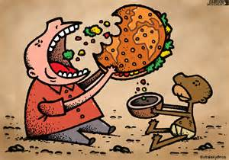
UK’s persistent Current Account deficit
UK trade deficit currently stands at approximately 3.2% of GDP. The causes of this include:
Deficit in trade in goods – large deficits in goods such as finished goods such as clothing, footwear and TVs but in also in areas such as fuels, beverages and tobacco. We also import vast quantities of semi-finished goods
Surplus in services exists e.g. in areas such as finance, but this is not significant enough to cover the deficit in goods
Financial flows – the UK is able to run a current account deficit due to success on the capital account i.e. we are able to attract foreign currency via portfolio investments and FDI
High consumption rates as well as a high marginal propensity to import

Slide 7
Does a Current Account deficit matter?
A current account deficit means that the UK has to attract foreign currency into the UK in order to finance import demand. The current account deficit is currently approximately -£16 billion, which means approximately £16billion of foreign currency needs to come into the economy to finance the current account deficit
Problems of a current account deficit:
Sign of poor competitiveness
If we cannot finance it via a capital account surplus, then the currency will depreciate, which leads to increased import prices and therefore reduced standards of living
Why we shouldn’t worry about a current account deficit:
Capital Account surplus finances it
We have a floating exchange rate system. An inability to finance a current account deficit would mean currency values would change to improve the current account

Slide 8
How does the BoP balance?
Numerical example:
If the UK imports £500million worth of cars from USA, then the UK will need to buy £500million worth of US $ - we would therefore need an inflow of money on the capital account
This can be achieved by the Americans depositing £500million worth of US $s into UK Banks. This money is then used to fund our demand for American cars
If we couldn’t attract foreign currency in to the UK, then in effect the supply of £’s would exceed the demand for £’s, which would lead to a currency depreciation to create equilibrium
The weaker currency would help reduce the trade deficit on the current account, which would eventually balance out the BoP

Slide 9
Capital Account
Long-term money flows include; portfolio investment and FDI
Short-term money flows are known as hot money. Here speculators move funds into different economies based on interest rates and expectations over future exchange rates. For example money will flow out of an economy if interest rates fall and investors speculate that the currency will depreciate
Hot money is said to be money flows created for reasons other than exports or investment
A problem created by hot money is that it can destabilise a currency and impact on trade

Slide 10
Importance of the City of London to the UK Economy
Since World War 2, many great UK cities have suffered because of deindustrialisation. Examples include Manchester, Newcastle and Birmingham. The last 30 years has however seen London boom and therefore becoming significantly important for the UK Economy
Facts about London:
Accounts for over 20% of UK GDP
30% of the UK’s fastest growing businesses
Large number of MNCs based in London
A world financial centre

Slide 11
Problems of trade imbalances
A trade imbalance exists when the value of imports doesn’t equal the value of exports. This therefore means that an economy is running either a trade deficit OR a trade surplus
Both trade deficits and surpluses can be bad for an economy:
Trade deficit = need for capital account surplus, unemployment and reduced AD
Trade surplus = inflationary risk and risk of currency appreciation
Economies therefore need to consider solving trade imbalances. Policies to create balanced trade include:
Deflating demand
Devaluation
Direct controls
Supply-side policies

Slide 12
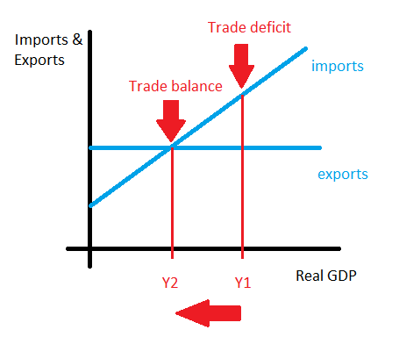
Solving a trade imbalance – deflating demand
Deflating demand involves deliberately reducing consumer spending through contractionary monetary and fiscal policy
If direct taxes are increased, interest rates are increased and the availability of credit will reduce consumption. This will reduce disposable income and if the marginal propensity to import is high, then this will reduce import demand and therefore reduce a trade deficit
Evaluation
This will not only lower import demand, but also demand for domestic output and therefore increase cyclical unemployment
How high is the marginal propensity to import?
Monetary would be quicker than fiscal

Slide 13
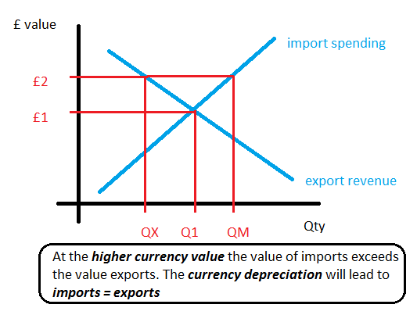
Solving a trade imbalance – devaluation
A currency devaluation (depreciation) will make imports more expensive and reduce exports prices. Imports will therefore fall and exports will therefore increase, which will reduce a trade deficit
Evaluation
For this to work we have to assume import and export demand is price elastic (Marshall-Lerner Condition). If its not, then import demand will not fall significantly, meaning £’s sacrificed to buy imports will increase
Devaluation can create cost-push inflation (higher priced imports)
Can lead to retaliation by other nations

Slide 14
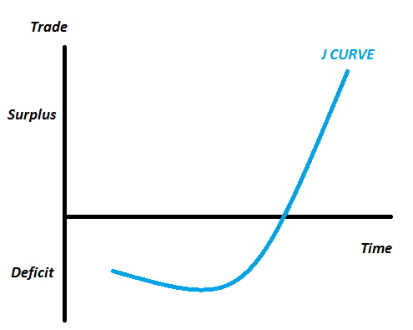
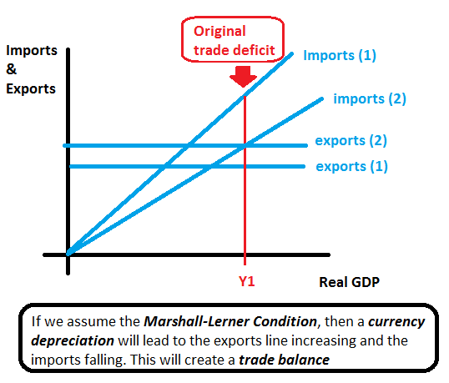
Solving a trade imbalance – devaluation

Slide 15
Solving a trade imbalance – direct controls
Here governments create barriers to import such as tariffs and quotas
Governments may also offer support for exporters such as subsidies
Evaluation
This can give infant-industries the ability to grow and expand BUT can also encourage inefficiency by domestic firms
Can lead to an increase in price levels (households and firms are increasingly forced to shift demand to more expensive domestic products)
In the short-run this will help, but can lead to retaliation in the long-run

Slide 16
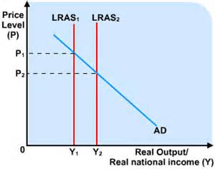
Solving a trade imbalance – supply-side policies
Supply-side policies create potential economic growth. They improve the quality and quantity of factors of production, which leads to an increase in output and productivity
Supply-side policies will therefore boost international competitiveness and therefore increase exports and reduce import demand
Evaluation
Effective long-run policy, but is not a quick fix i.e. will not help in the short-run

Slide 17
Solving a trade surplus
A trade surplus can be reduced by:
Inflating domestic demand
Currency appreciation
Removing protectionist policies

