Slide 1
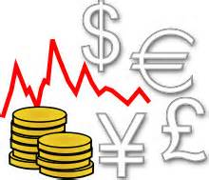
ECON 4
TOPIC 7) EXCHANGE RATE
SYSTEMS

Slide 2
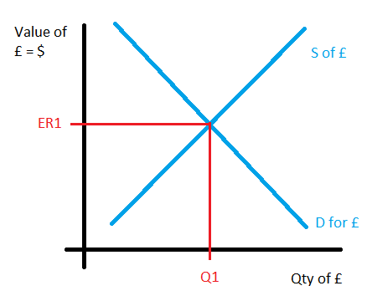
Exchange rates
The exchange rate is the rate at which one currency can be exchanged for another
The value of a currency is determined through foreign exchange trading. The biggest traders of foreign currency include; businesses, international investors and governments
This means that the value of a currency is determined by market forces i.e. the demand & supply

Slide 3
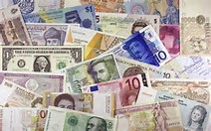
What affects the value of a currency?
Currencies can either appreciate (increase in value against another currency OR depreciate (decrease in value against another currency)
Currency values will change based on:
Inflation rates – low inflation will lead to exports becoming more competitively priced. This will raise the demand for our exports = increased demand for £ = currency appreciation
Interest rates – High interest rates = increased flow of hot money into UK = currency appreciation
Speculation – If speculators believe a currency will appreciate, demand for £ will increase = currency appreciation
Change in competitiveness – increased exports and reduced imports = currency appreciation

Slide 4
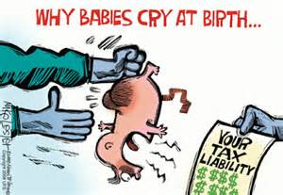
What affects the value of a currency?
Currency values will change based on:
Relative strength of other currencies – if other major currencies are losing value or face uncertainty, investors will move their currency to £ = currency appreciation
Balance of payments – if an economy with a current account deficit struggles to attract capital flows then a currency will depreciate
Government debt – high govt debt will mean investors sell those bonds due to risk of default = currency depreciation
Government intervention – an economy can keep their currency low by buying financial assets in other currencies

Slide 5
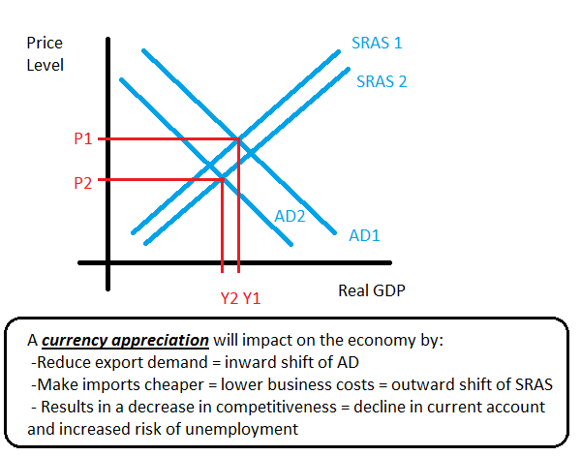
Impacts of currency appreciation on the economy
Impact depends on:
Price elasticity of demand
Can businesses adapt? E.g. cut profit margins OR raise efficiency to cut costs?
Time-lags – impacts may have minimal impacts in the short-run
Can AD shift be overcome via monetary and fiscal policy?
Size of change of exchange rate
Size of negative multiplier
What stage of the economic cycle does the change happen at?

Slide 6
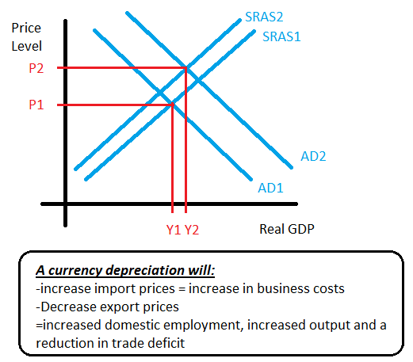
Impacts of currency depreciation on the economy
Impact depends on:
Price elasticity of demand
Can businesses adapt? E.g. cut profit margins OR raise efficiency to cut costs?
Time-lags – impacts may have minimal impacts in the short-run
Can AD shift be overcome via monetary and fiscal policy?
Size of change of exchange rate
Size of negative multiplier
What stage of the economic cycle does the change happen at?

Slide 7
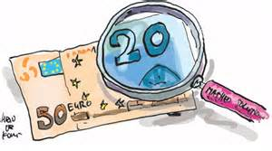
Fixed exchange rate
A fixed exchange rate occurs when an economy attempts to keep its currency value at a certain level against another currency.
A semi-fixed exchange rate exists when an economy allows a small change in a currency value
Here monetary policy is used to maintain the currency value. Interest rates are adjusted to influence inflows and outflows of money. Governments also hold foreign currency reserves, which are bought and sold to maintain the domestic currency value
The Exchange Rate Mechanism (ERM) was an example of a semi-fixed exchange rate system,. Here many European economies attempted to fix their currency value against the German Deutsch Mark (DM)

Slide 8
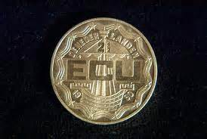
Fixed exchange rate
Benefits
Drawbacks
Conflicts with other targets e.g. a weak currency will mean interest rates are increased – this can lower AD and employment at the expense of the currency value
Can lead to an overvalued currency – this will mean that products will be relatively more expensive – this leads to falling exports and increasing imports
Inability to depreciate to boost competitiveness – big problem for EU countries such as Greece and Portugal. These economies now have to focus on deflationary policies such as increased tax to lower import demand
Supports international trade and price stability – importers and exporters can predict future prices – allows firms to plan ahead
Stability of prices = incentives for investment

Slide 9
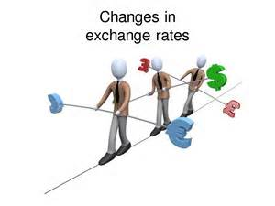
Floating exchange rate
A floating exchange rate occurs when the currency value is solely determined by market forces and governments do not attempt to influence its value.
Some economies have been known to operate a dirty floating exchange rate. This is where on occasions governments may intervene to influence the currency value

Slide 10
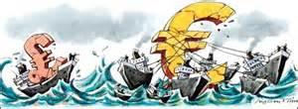
Floating exchange rate
Benefits
Drawbacks
Automatic balance of payments adjustment – trade deficit = currency depreciation = increased exports and lower imports
Freeing monetary and fiscal policy for other targets e.g. lower interest rates to deal with a recession, will weaken the currency – this will actually help end the recession by promoting export demand
Lower need to hold foreign currency reserves – money can therefore be used in other ways such as government spending
Uncertainty over currency value = negative impact on firms. This can cut investment and lower international trade
Lack of discipline – high inflation will not be punished because the currency would depreciate to help firms overcome inefficiencies
Inflation caused by currency depreciation
Will currency values change to reduce trade deficits? Marshall Lerner condition says that this is unlikely in the short-run

