Slide 1
ECON 4
TOPIC 8) European
union

Slide 2
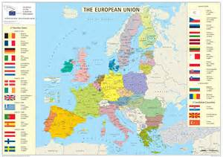
European Union (EU)
The EU is a sophisticated form of economic integration between 28 European nations
The EU is a customs union. This means the members have free trade with each other, but a common external tariff with non-members. This means any trade agreements with any other country are negotiated by the EU on behalf of all member states
The EU is also a single market. This involves free trade, free movement of people, free movement of capital and harmonization of taxes and economic laws
EU at its heart is also a Monetary Union. This involved a common currency (Euro) and common monetary policy for Euro members

Slide 3
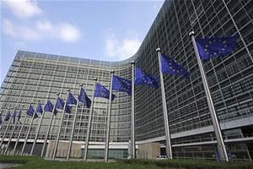
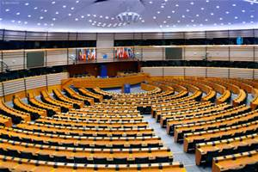
EU Institutions
European Commission
The Commission makes sure that EU decisions are properly implemented and supervises the way EU funds are spent.
It also keeps an eye out to see that everyone abides by the European treaties and European law.
The Commissioners are assisted by an administration of about 25,000 civil servants.
European Parliament
Directly-elected EU body with legislative, supervisory, and budgetary responsibilities
European Central Bank
The ECB administers the monetary policy of eurozone states, acting as the region’s central bank.
Other EU institutions include; Council of Minsters, European Council, The Court of Justice

Slide 4
Single market
Benefits
Costs
Trade creation – production increasingly based on comparative advantage = increased output and economic welfare
Increased economies of scale
Increased competition
Labour migration helps economies fill skill gaps and increase productive capacity
Increased capital and technology spread across members = increased productivity
Increased political and economic influence of EU members on a global scale
Possible structural change problems
Trade diversion – membership may mean a member is now not able to trade freely with a non-member. This can lead to trade being diverted away from a non-member to a more expensive member nation
Labour migration places strains on welfare and housing within richer members
Common Agricultural Policy (CAP) – subsidy on EU food production (high cost)

Slide 5
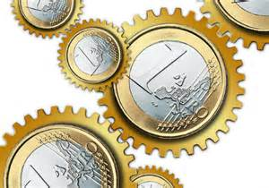
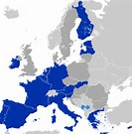
Monetary Union
Monetary Union involves members adopting the Euro as their currency and the ECB becoming the central bank for member nations
To join the Euro economies must meet the following criteria:
Inflation can be no more than 1.5% higher than the average of the 3 best performers in terms of price stability
Stable exchange rate
Sound government finances – total govt debt not to exceed 60% of GDP & annual budget deficit must not exceed 3% of GDP
Interest rate convergence – 5 year treasury bonds must have an interest rate no more than 2% above the average for Euro Zone members

Slide 6
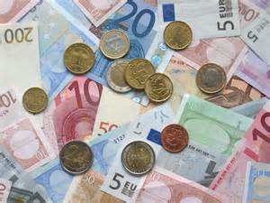
Joining the Euro
Benefits
Drawbacks
Reduced transaction costs = increased trade and investment
Financial support – ECB = lender of last resort
Inability to determine own interest rates
Increased exposure to Eurozone economic problems

Slide 7
The UK and the Single Currency
The UK opted out of the Euro at the time of the 1993 Maastricht Treaty
The Coalition government (in power since 2010) has no plans to consider entry. Britain will remain outside of the Euro Area
Britain operates with a floating exchange rate and an independent central bank – it has the flexibility to change monetary policy to suit domestic needs – for example to increase the size of quantitative easing or to find other ways of unfreezing the supply of loans to businesses.
This freedom is not necessarily available to countries part of the Euro Zone.

Slide 8
EU Expansion
Since 1993 we have had 13 new members of the EU. These have been from East Europe e.g. Romania, Poland and Czech Republic
This is seen as beneficial because it has expanded EU by 100 million people and therefore increased the benefits of international trade further BUT only added 5% extra to EU GDP, which means they tend to be developing economies
Led to lots of East European migration to richer EU countries
Capital has moved from wealthy to these developing EU members

Slide 9
EU EXPANSION

Slide 10
Why do EU residents from new members want to come to the UK?

Slide 11
Is migration a good thing for the UK?

Slide 12
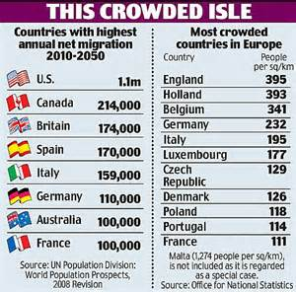
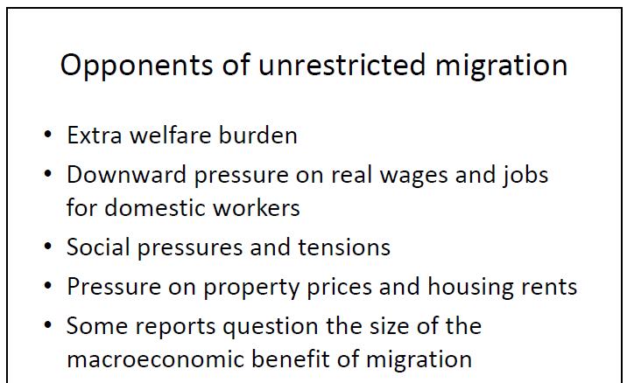
Is migration a good thing for the UK?

