Slide 1
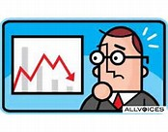
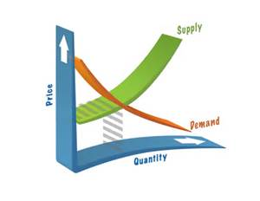
A Level Economics Induction 2015/16
Name:______________________________________________

Slide 2
A Level Economics
Unit | Unit title
1 | Markets and market failure (micro)
2 | The national economy (macro)
3 | Business economics and the distribution of money (micro)
4 | The national and international economy (macro)
Course structure
Sept – Jan = Econ 4
Jan – May = Econ 3
AS grade | AS points | A2 grade | A2 points
A | 160 | A* | 320 (90 ave. at A2)
B | 140 | A | 320
C | 120 | B | 280
D | 100 | C | 240
E | 80 | D | 200
 |  | E | 160

Slide 3
A2 exam papers
Each A2 exam paper consists of:
SECTION A (either context 1 or context 2). Here you are required to use a case study to answer the following:
5 mark data questions
10 mark analysis question
25 mark essay question
SECTION B (either essay 1, 2 OR 3). Here you are required to complete the following without a case study:
15 mark analysis question
25 mark essay question

Slide 4
Self-reflection
What grade did you achieve at AS?
Were you happy with this grade?
What grade are you targeting for A Level Economics?
What did you do that worked last academic year?
If you could start again what would you do differently?
ACTIVITY 1

Slide 5
What do you remember about ECON 2?
A2 Economics will build on knowledge acquired at AS. This means that AS is now the basics, which I will assume that you understand when we start A2.
Work in small groups to prepare a presentation which demonstrates good knowledge of Econ 2. This must include;
Diagrams
Core key terms
An ability to analyse key macroeconomic theory
ACTIVITY 2

Slide 6
ECON 2 in a nutshell
Macroeconomic target | Measured by
Economic growth (actual & potential) | Change in GDP
Low unemployment | ILO & Claimant Count
Low, stable inflation (2%) | RPI & CPI
Satisfactory balance of payments | Current Account
Reduce budget deficits | Government spending – Taxation receipts
Diagrams
AD/SRAS & LRAS
Circular flow of income
Business cycle
PPB
Macro policies
Fiscal policy
Monetary policy
Supply-side policies

Slide 7
Macroeconomic indicators
To succeed at A2, reading around the subject is vital. When reading about economics in the news, lots of data is used to indicate how the economy is performing.
With this in mind, identify a range of evidence that could be gathered to evidence that an economy is experiencing an economic recovery
ACTIVITY 3

Slide 8
PEEEL
Is economic growth in India good for the UK Economy?
Is a growth in unemployment always bad for an economy?
Is a currency appreciation bad for an economy?
If an economy experiences an increase in the rate of inflation is this necessarily bad for future economic performance?
Is an increase in government spending good for an economy?
POINT
EXPLAIN
EVIDENCE
EVALUATE
LINK BACK TO QUESTION
ACTIVITY 4

Slide 9
Contrasting economic ideas
Many different views exist over the best way to manage and run an economy. Research the following:
Theory | Main ideas | Advantages | Disadvantages | When was this theory popular?
Classical Economics
Keynesian Economics
Monetarism
ACTIVITY 5

